Slide 1

सड़क परिवहन और राजमार्ग मंत्रालय
Ministry of Road Transport and Highways

Slide 2
सड़क परिवहन और राजमार्ग मंत्रालय
Ministry of Road Transport and Highways
Title of your Presentation
A longer subtitle of your presentation
Presenter Details

Slide 3

सड़क परिवहन और राजमार्ग मंत्रालय
Ministry of Road Transport and Highways
Table of Contents
1. Introduction
4. Timelines/ Milestones
Place the reference text here.
Place the reference text here.
2. Overview of Ministry
5. Fund Utilization
Place the reference text here.
Place the reference text here.
3. Activity Status
6. Way Forward
Place the reference text here.
Place the reference text here.

Slide 4
सड़क परिवहन और राजमार्ग मंत्रालय
Ministry of Road Transport and Highways
Table of Contents
1. Introduction
4. Timelines/ Milestones
Place the reference text here.
Place the reference text here.
2. Overview of Ministry
5. Fund Utilization
Place the reference text here.
Place the reference text here.
3. Activity Status
6. Way Forward
Place the reference text here.
Place the reference text here.

Slide 5






सड़क परिवहन और राजमार्ग मंत्रालय
Ministry of Road Transport and Highways
Table of Contents
Introduction
Overview of Ministry
Activity Status
Timelines/ Milestones
Fund Utilization
Way Forward

Slide 6




सड़क परिवहन और राजमार्ग मंत्रालय
Ministry of Road Transport and Highways
Title of the Slide
Place Title description here.
Sub-heading
One
Sub-heading
Two
Sub-heading
Three
Place sub-heading here.
Place sub-heading here.
Place sub-heading here.

Slide 7






सड़क परिवहन और राजमार्ग मंत्रालय
Ministry of Road Transport and Highways
Title of the Slide
Place Title description here.
Sub-heading
This is a dummy text introducing the subject of presentation
Sub-heading
This is a dummy text introducing the subject of presentation
Sub-heading
This is a dummy text introducing the subject of presentation

Slide 8










सड़क परिवहन और राजमार्ग मंत्रालय
Ministry of Road Transport and Highways
Title of the Slide
Place Title description here.
Sub-heading
Place the sub-heading description here.
Sub-heading
Place the sub-heading description here.
Sub-heading
Place the sub-heading description here.
Sub-heading
Place the sub-heading description here.

Slide 9
सड़क परिवहन और राजमार्ग मंत्रालय
Ministry of Road Transport and Highways
Title of the Slide
Place Title description here.
Sub Heading
Place the sub-heading description here.
Place the sub-heading description here.
Sub Heading
Place the sub-heading description here.
Place the sub-heading description here.
Sub Heading
Place the sub-heading description here.
Place the sub-heading description here.

Slide 10
सड़क परिवहन और राजमार्ग मंत्रालय
Ministry of Road Transport and Highways
Title of the Slide
Place Title description here.
Sub Heading one
Place the sub-heading description here.
Sub Heading two
Place the sub-heading description here.
Place the sub-heading description here.
Sub Heading three
Place the sub-heading description here.
Place the sub-heading description here.
Place the sub-heading description here.

Slide 11
सड़क परिवहन और राजमार्ग मंत्रालय
Ministry of Road Transport and Highways
Title of the Slide
Place Title description here.
Sub Heading one
This is a reference text for subheading. Font size will be 16 px.
This is a reference text for subheading. Font size will be 16 px.
Sub Heading two
This is a reference text for subheading. Font size will be 16 px.
This is a reference text for subheading. Font size will be 16 px.
Sub Heading three
This is a reference text for subheading. Font size will be 16 px.
This is a reference text for subheading. Font size will be 16 px.

Slide 12
सड़क परिवहन और राजमार्ग मंत्रालय
Ministry of Road Transport and Highways
Title of the Slide
Place Title description here.
Sub Heading one
Sub Heading two
Sub Heading three
Sub Heading
Item 1
Item 2
Item 3
Item4
Item 5

Slide 13
सड़क परिवहन और राजमार्ग मंत्रालय
Ministry of Road Transport and Highways
Title of the Slide
Place Title description here.
Sub Heading
This is a reference text for subheading. Font size will be 14 px.
Sub Heading
This is a reference text for subheading. Font size will be 14 px.
Sub Heading
Sub Heading
This is a reference text for subheading. Font size will be 14 px.
This is a reference text for subheading. Font size will be 14 px.

Slide 14
सड़क परिवहन और राजमार्ग मंत्रालय
Ministry of Road Transport and Highways
Title of the Slide
Place Title description here.
Sub Heading
Item 1
Item 2
Sub Heading
Item 1
Item 2
Sub Heading
Item 1
Item 2
Item 3
Item 3
Item 3
Sub Heading
Item 1
Item 2
Item 3

Slide 15
सड़क परिवहन और राजमार्ग मंत्रालय
Ministry of Road Transport and Highways
Title of the Slide
Place Title description here.
Sub heading one
Sub heading two
Sub heading three
Sub heading four
Sub heading five

Slide 16
सड़क परिवहन और राजमार्ग मंत्रालय
Ministry of Road Transport and Highways
Title of the Slide
Place Title description here.
Sub heading
Place sub heading description here
Place sub heading description here
Place sub heading description here

Slide 17
सड़क परिवहन और राजमार्ग मंत्रालय
Ministry of Road Transport and Highways
Title of the Slide
Place Title description here.

Slide 18
सड़क परिवहन और राजमार्ग मंत्रालय
Ministry of Road Transport and Highways
Title of the Slide
Place Title description here.

Slide 19
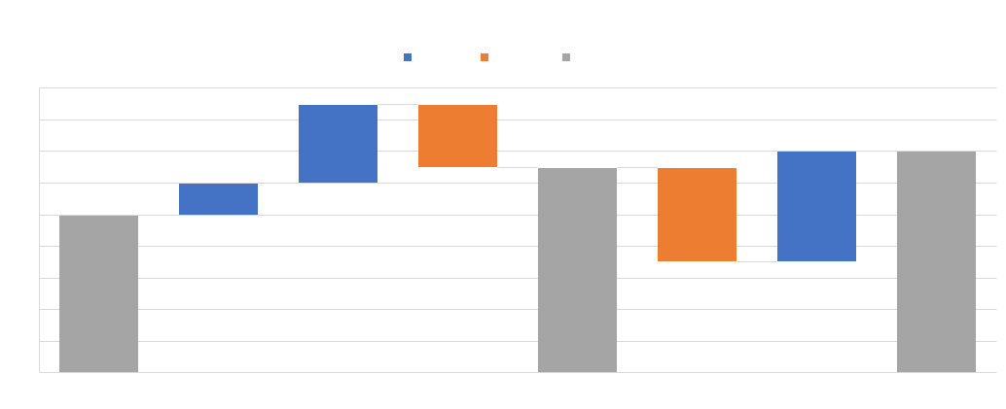
सड़क परिवहन और राजमार्ग मंत्रालय
Ministry of Road Transport and Highways
Title of the Slide
Place Title description here.

Slide 20
सड़क परिवहन और राजमार्ग मंत्रालय
Ministry of Road Transport and Highways
Title of the Slide
Place Title description here.

Slide 21
सड़क परिवहन और राजमार्ग मंत्रालय
Ministry of Road Transport and Highways
Title of the Slide
Place Title description here.
Sub heading 01
Sub heading 02
01
02
Place sub heading text here.
Place sub heading text here.
04
03
Sub heading 04
Sub heading 03
Place sub heading text here.
Place sub heading text here.

Slide 22
सड़क परिवहन और राजमार्ग मंत्रालय
Ministry of Road Transport and Highways
Title of the Slide
Place Title description here.
1
2
3
4
5
Sub heading
Sub heading
Sub heading
Sub heading
Sub heading
Place sub heading text here
Place sub heading text here
Place sub heading text here
Place sub heading text here
Place sub heading text here

Slide 23
सड़क परिवहन और राजमार्ग मंत्रालय
Ministry of Road Transport and Highways
Title of the Slide
Place Title description here.
Sub heading one
Sub heading two
Sub heading three
Sub heading four
Sub heading five

Slide 24
सड़क परिवहन और राजमार्ग मंत्रालय
Ministry of Road Transport and Highways
Title of the Slide
Place Title description here.
Sub heading one
Sub heading two
Sub heading three
Sub heading four

Slide 25
सड़क परिवहन और राजमार्ग मंत्रालय
Ministry of Road Transport and Highways
Title of the Slide
Place Title description here.
Sub heading one
Place the sub-heading description here.
Place the sub-heading description here.
Sub heading two
Place the sub-heading description here.
Place the sub-heading description here.
Sub heading three
Place the sub-heading description here.
Place the sub-heading description here.
Sub heading four
Place the sub-heading description here.
Place the sub-heading description here.

Slide 26
सड़क परिवहन और राजमार्ग मंत्रालय
Ministry of Road Transport and Highways
Title of the Slide
Place Title description here.
Sub heading one
Place sub heading description here
Sub heading two
Place sub heading description here
Sub heading three
Place sub heading description here

Slide 27
सड़क परिवहन और राजमार्ग मंत्रालय
Ministry of Road Transport and Highways
Title of the Slide
Place Title description here.
Sub Heading One
Place the sub heading description here.
Sub Heading Two
Place the sub heading description here.
Sub Heading three
Place the sub heading description here.

Slide 28
सड़क परिवहन और राजमार्ग मंत्रालय
Ministry of Road Transport and Highways
Title of the Slide
Place Title description here.
Sub heading one
Place the sub-heading description here.
Sub heading two
Place the sub-heading description here.
Place the sub-heading description here.
Sub heading three
Place the sub-heading description here.
Place the sub-heading description here.
Place the sub-heading description here.

Slide 29

सड़क परिवहन और राजमार्ग मंत्रालय
Ministry of Road Transport and Highways
Transparency in governance leads to greater responsibility towards people and a sense of accountability, which in turn bring changes in work culture and impact of (government) schemes.”
-Hon'ble Prime Minister of India,
Shri Narendra Modi

